Slide 1

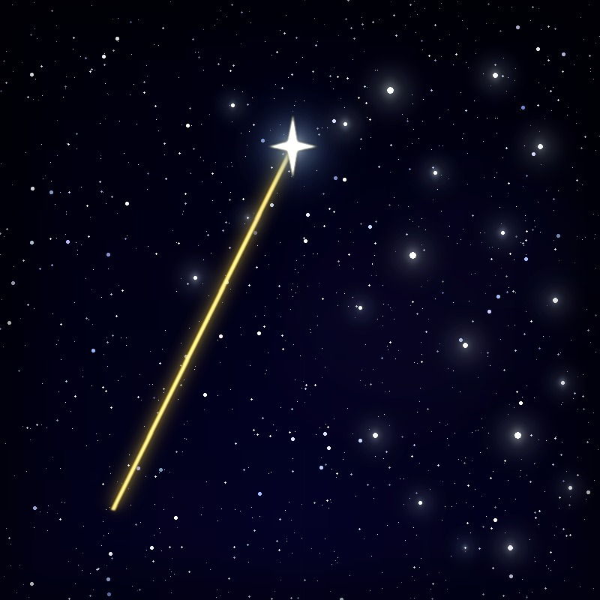
THE ASTRO IMAGING CHANNEL
Hocus Focus v4
Every star matters
Star detection optimization, tilt adapter calibration, and guided tilt correction for N.I.N.A.
George Hilios
jokogeo on Discord · ghilios on Cloudy Nights
Notes:
Welcome back. In 2023 I gave a talk here called "The Science of Star Measurement" — how Hocus Focus detects and measures stars, fits focus curves, and models your sensor's tilt and backfocus.
Tonight is the sequel: what's new in Hocus Focus v4. The title is the spoiler — "every star matters" — and by the end you'll see why that one idea explains most of what changed.
Please interrupt with questions; I've also left natural pauses between the three chapters.

Slide 2

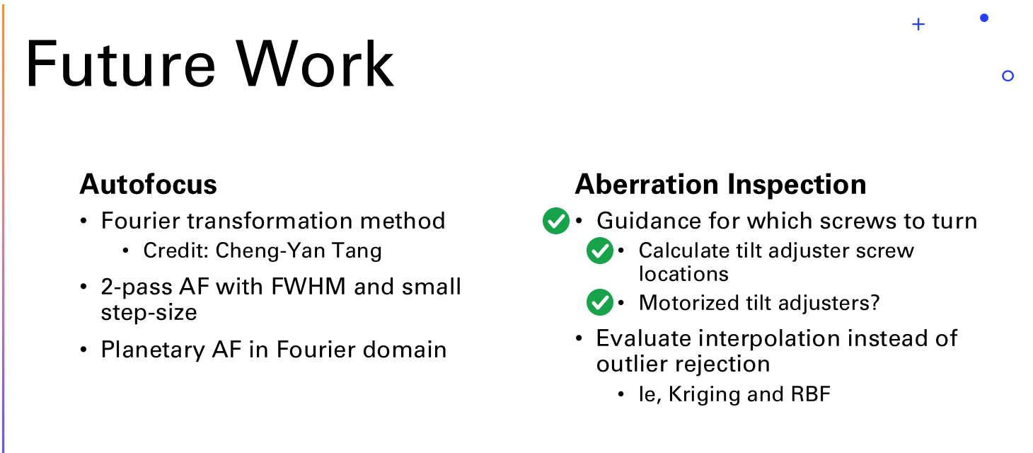
Where we left off
THE 2023 TALK
How stars are detected and measured, how focus curves are fit, and how a sensor model separates tilt from backfocus.
Three promises from 2023.
All three shipped in v4.
The last slide of the 2023 talk
Notes:
This is the actual last content slide from the 2023 talk — my "future work" list.
Three of those bullets were about tilt: tell people which screws to turn, work out where the screws are, and — with a question mark — motorized tilt adjusters.
All three shipped in v4, and they're the back half of tonight's talk.
If you missed 2023: that talk covered how stars are detected and measured (HFR, FWHM/PSF fitting), how the hyperbolic focus curve is fit, and how the sensor model separates tilt from backfocus. The recording is on TAIC's channel. I'll do a 60-second recap of the sensor model when we get there.

Slide 3
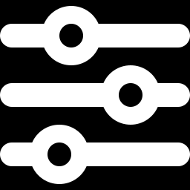
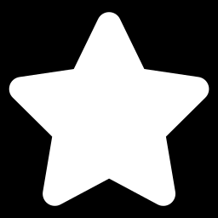
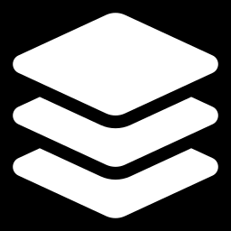
What's new in v4
01
02
03
Fewer decisions
More stars
Flat sensors
The Optimization Wizard
Export and import
Every setting documented
Donut detection
Adaptive binarization
Better fits, frame review
The Calibration Wizard
Guided and automatic fixes
Indoor simulators
Notes:
Three chapters.
One — fewer decisions: the Star Detection Optimization Wizard, which answers the number-one complaint I hear: too many settings.
Two — more stars: donut detection, locally adaptive binarization, better hyperbolic fits, and a way to review every frame of an autofocus run.
Three — flat sensors: the Tilt Adapter Calibration Wizard, guided and fully automated tilt and backfocus correction, and simulators so you can practice all of it indoors.
I'll pause for questions between chapters.

Slide 4
01
Fewer decisions
The Star Detection Optimization Wizard, and why the settings exist at all
Notes:
Chapter one: the optimizer. I'll start with the complaint it answers.

Slide 5
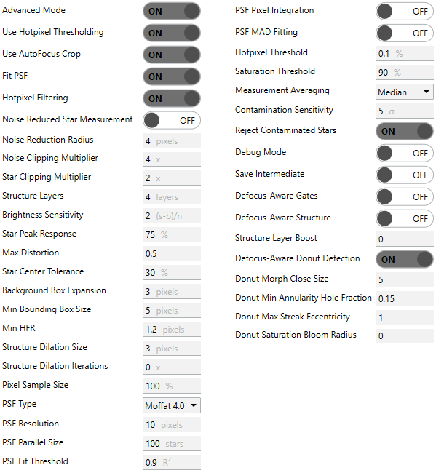

01 FEWER DECISIONS 02 MORE STARS 03 FLAT SENSORS
“There are too many settings”
40+
star detection settings in Advanced mode. The #1 complaint from the community.
GOOD NEWS #1
Every setting is now fully documented
What it does, when to touch it, and what it trades off.
scan for the docs
ghilios.github.io/hocus-focus/settings
Notes:
This is the number-one complaint about Hocus Focus, and it's fair. This is the advanced Star Detector list — it doesn't even fit on one screen.
Two pieces of good news. First: every one of these is now fully documented — what it does, when to change it, and what it costs you. The QR code goes straight there.
Don't try to read the list. We'll come back to this wall of settings later, and it will make a lot more sense.
Docs: https://ghilios.github.io/hocus-focus/settings/

Slide 6
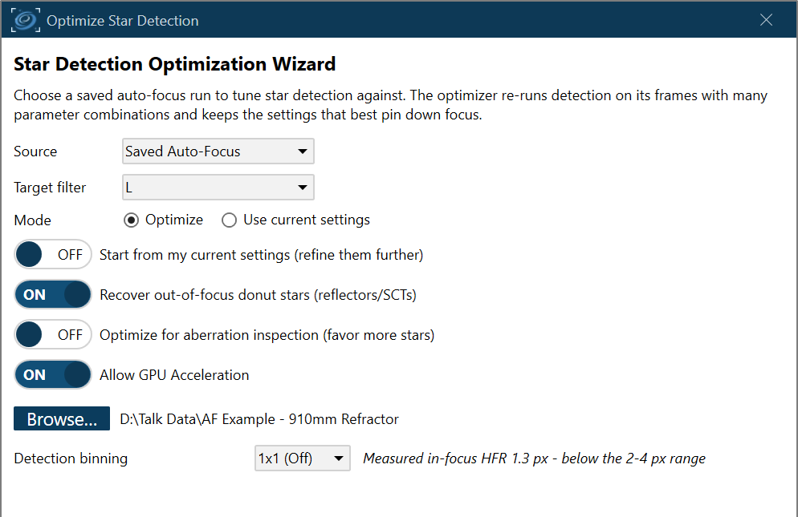
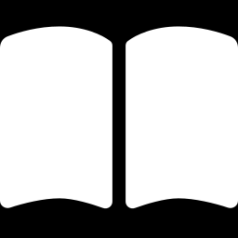
01 FEWER DECISIONS 02 MORE STARS 03 FLAT SENSORS
Good news #2: you don't have to set them
THE OPTIMIZATION WIZARD
Point it at a saved autofocus run, or let it capture one live
It re-runs star detection on those frames with many combinations of settings
It keeps what best pins down focus for your rig and your sky
ghilios.github.io/hocus-focus/optimization
REMEMBER THESE TWO SWITCHES
Recover out-of-focus donut stars
Optimize for aberration inspection
Notes:
The second piece of good news is the Star Detection Optimization Wizard. One button on the Star Detector options page.
You point it at a saved autofocus run — a folder of frames you already captured — or have it capture a fresh sweep live. It re-runs star detection on those frames with many combinations of settings and keeps the combination that best pins down focus for your telescope, camera and sky.
Options on this page: recover out-of-focus donut stars (for reflectors and SCTs), and optimize for aberration inspection — remember that one, it matters later. With per-filter star detection enabled you can tune each filter separately.
Docs: https://ghilios.github.io/hocus-focus/optimization/

Slide 7
So why are there so many settings?
It comes down to something everyone here already obsesses over…
SNR
Hold that thought.
Notes:
But that raises the obvious question: if a wizard can pick them, why do all those settings exist in the first place?
I'm going to hold the full answer until later, but here's the hint: it comes down to something every one of you already obsesses over when you plan an imaging night — signal-to-noise ratio. SNR.
Hold that thought. When this amber tag comes back, we're paying it off.

Slide 8
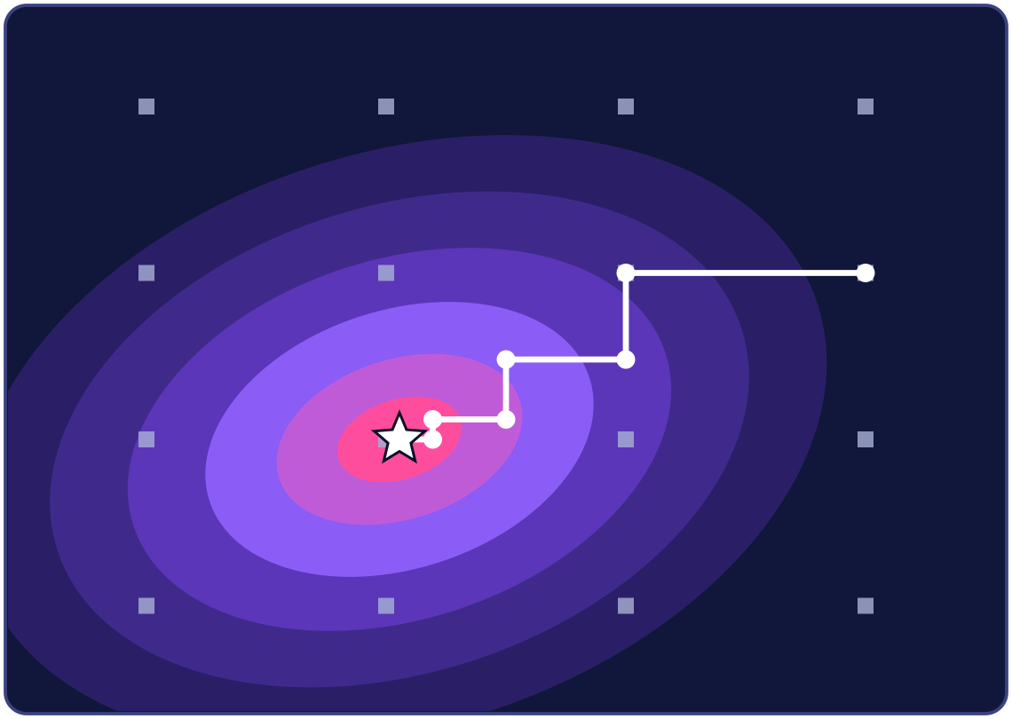
01 FEWER DECISIONS 02 MORE STARS 03 FLAT SENSORS
It tries a few hundred combinations for you
Saved autofocus frames
Try a set of settings
Re-detect stars in every frame
Fit the focus curve
Score it
repeat a few hundred times
A methodical search. No randomness, so the same frames give the same answer
Each candidate is judged by how precisely the frames pin down best focus
It never hands back anything worse than what you have now
Brighter = better score · dots = a coarse first pass · white path = the search
ghilios.github.io/hocus-focus/optimization
Notes:
Conceptually it's a loop. Take the saved autofocus frames. Pick a candidate set of detection settings. Re-detect stars in every frame. Fit the focus curve. Score how good that result is. Then move to the next candidate — a few hundred times.
The search is methodical rather than random. The picture shows the idea with just two settings: brighter means a better score, the grey squares are a coarse first pass, and the white path is the search walking uphill and taking smaller steps as it closes in. Same input, same answer, every time.
And it has a safety rail: it will never hand you back settings that score worse than what you already have. Worst case it says "no change".
Backup detail if asked: about a dozen settings are searched (around 20 with donut recovery on), budget of roughly 250–400 evaluations, and results are cached so repeat visits are free. Optional: you can label missed or bogus stars and re-optimize with that feedback.

Slide 9
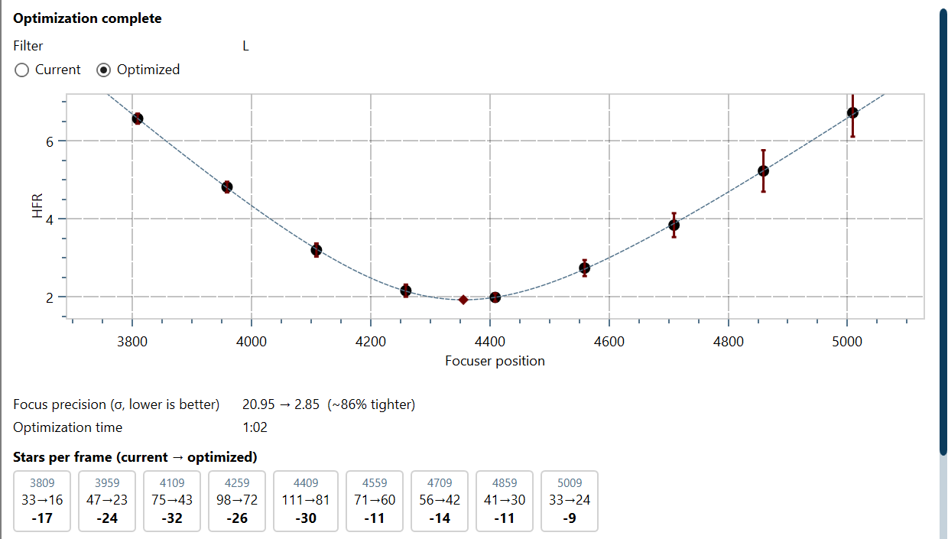
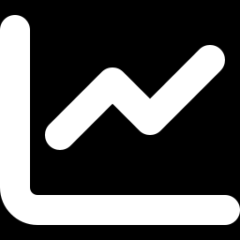
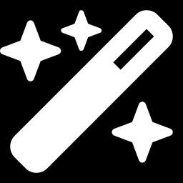
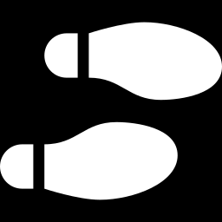
01 FEWER DECISIONS 02 MORE STARS 03 FLAT SENSORS
You get a tighter curve, and advice
A tighter focus curve
Before and after, with the focus precision for each
Stars per frame, position by position
Counted at every focuser position, not just at best focus
Autofocus advice
A step size that suits your curve, and a longer exposure when the frames need it
ghilios.github.io/hocus-focus/optimization
Notes:
When it finishes you get a summary. You can flip between the focus curve with your current settings and the optimized one, see the focus precision, and see stars per frame at every focuser position.
It also recommends an autofocus step size — and, when the frames are starved of signal, a longer exposure.
From here: Accept applies it. Review frames lets you look at the detections and label mistakes. Continue optimizing runs another pass.
Docs: https://ghilios.github.io/hocus-focus/optimization/

Slide 10
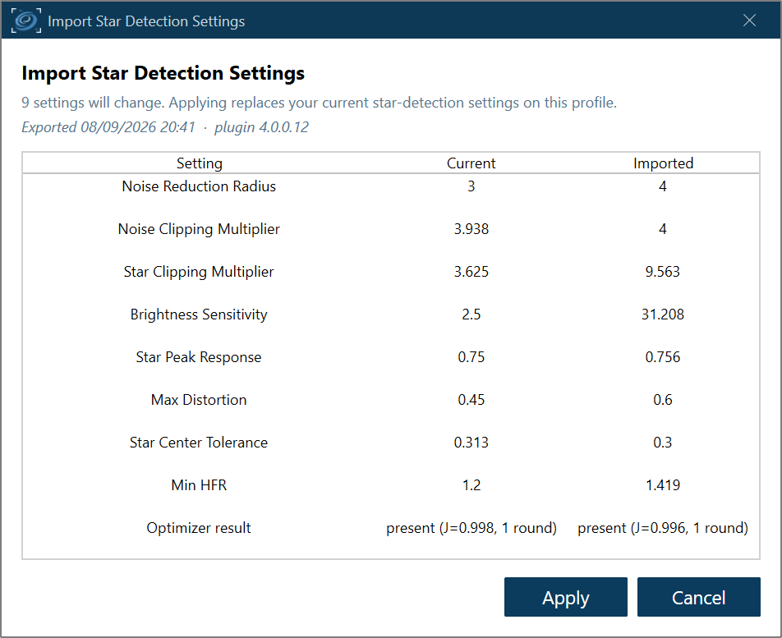
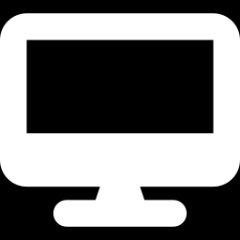
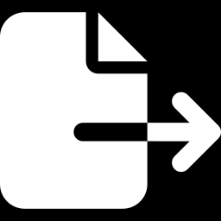
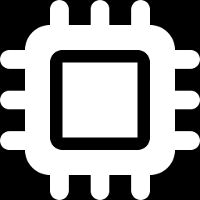
01 FEWER DECISIONS 02 MORE STARS 03 FLAT SENSORS
It's a lot of computing
20–30 min
on a typical imaging PC. Every frame is re-detected a few hundred times.
Run it on another computer
Copy a saved autofocus folder to your desktop PC
Export, then import
Carry the optimized settings back as a single file
GPU acceleration
Import shows exactly what will change before anything is applied
New: one toggle on the wizard's start page
ghilios.github.io/hocus-focus/settings
Notes:
The honest catch: this is heavy. Every candidate means re-detecting stars in every frame of the run, a few hundred times over. On a typical imaging mini-PC, plan on 20 to 30 minutes — longer for big sensors.
Three things help. One: you don't have to run it at the telescope. Copy a saved autofocus folder to your desktop and optimize there. Two: Export and Import move the optimized settings back to the imaging PC as a single file; import shows you exactly what will change before anything is applied. Three: there's now GPU acceleration — one toggle on the wizard start page.
Docs (export/import section is on the settings page): https://ghilios.github.io/hocus-focus/settings/

Slide 11
02
More stars, better curves
Donut detection · adaptive binarization · hyperbolic fits · frame review
Pause: questions so far?
Notes:
Pause here for questions on the optimizer.
Chapter two is a quick tour of four improvements to detection and autofocus itself. I'm going to keep each of these to the headline — every one has a full page in the documentation, and the link is at the bottom of each slide.

Slide 12
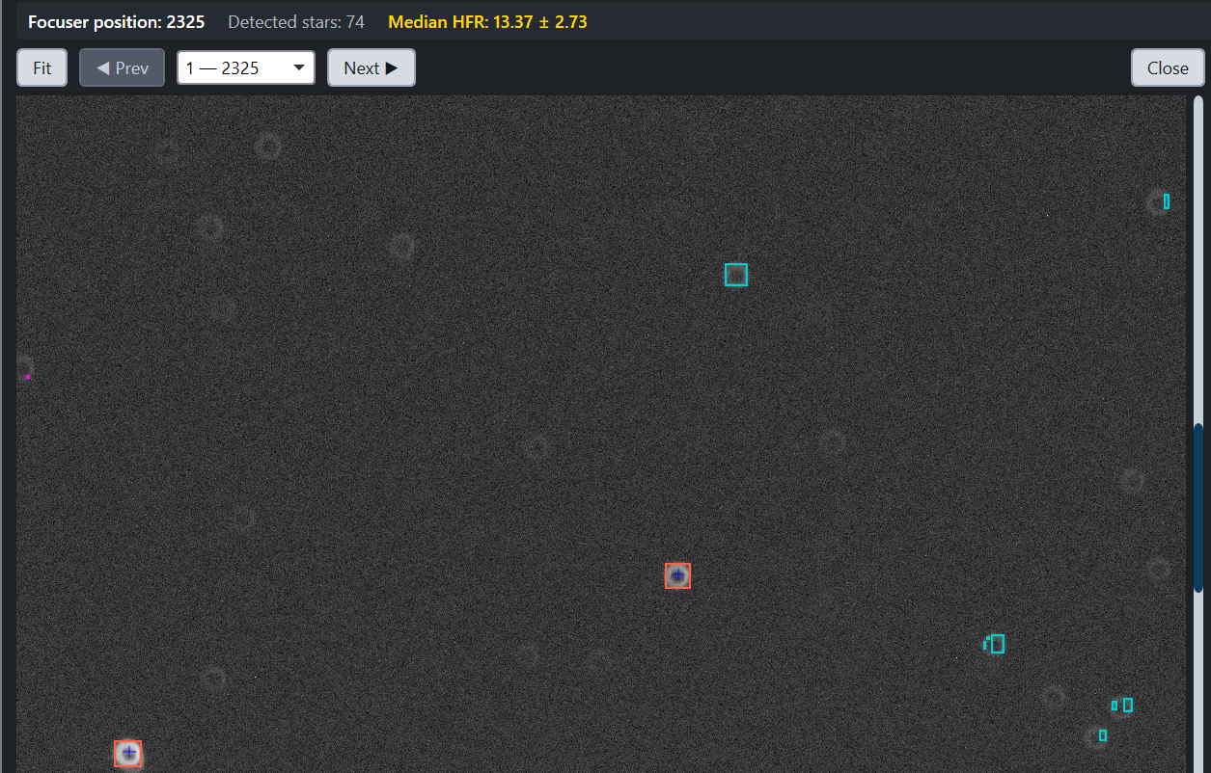
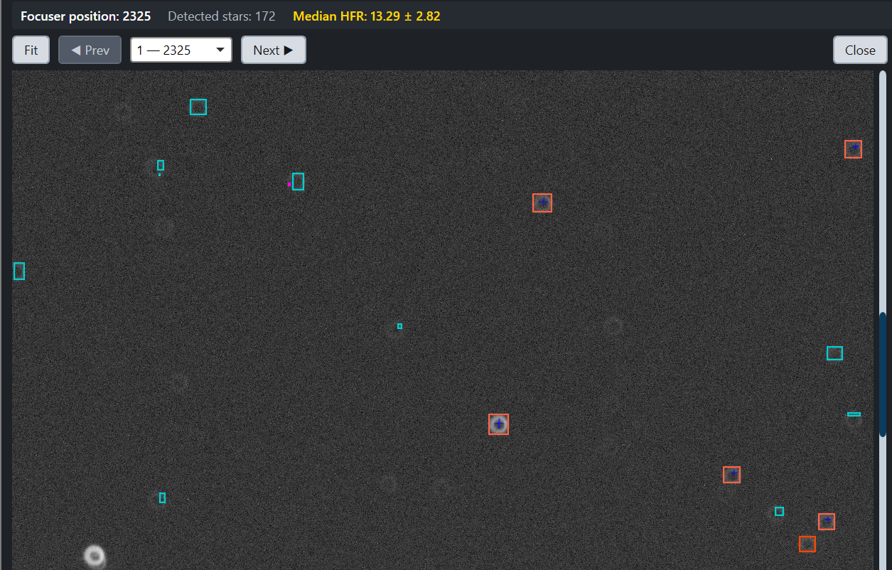

01 FEWER DECISIONS 02 MORE STARS 03 FLAT SENSORS
Out-of-focus donut stars are no longer thrown away
DONUT DETECTION
In focus
Out of focus
With a central obstruction (Newtonian, SCT, RC), a defocused star is a ring with a hole.
The old detector rejected them as too fragmented or too “distorted”
v4 recognizes the ring and keeps the star
Opt-in: flip one toggle, or let the optimizer decide
ghilios.github.io/hocus-focus/settings/donut-aware
Notes:
If you have a central obstruction — a Newtonian, an SCT, an RC — your out-of-focus stars aren't blobs, they're donuts: a bright ring with a hole in the middle.
The old detector threw most of those away. The ring breaks up into arcs, so the pieces look too small; and a hollow ring fails the shape test, so it looks too distorted.
v4 recognizes the ring for what it is and keeps the star. That gives autofocus real data at the ends of the sweep, where it used to be starved.
It's opt-in: a toggle in the settings, or tick "Recover out-of-focus donut stars" in the optimizer and let it work out the details.
Backup: recovery only affects which stars are accepted — it never changes a star's measured HFR. Truly faint rings with no core remain noise-limited for any detector.
Docs: https://ghilios.github.io/hocus-focus/settings/donut-aware/

Slide 13
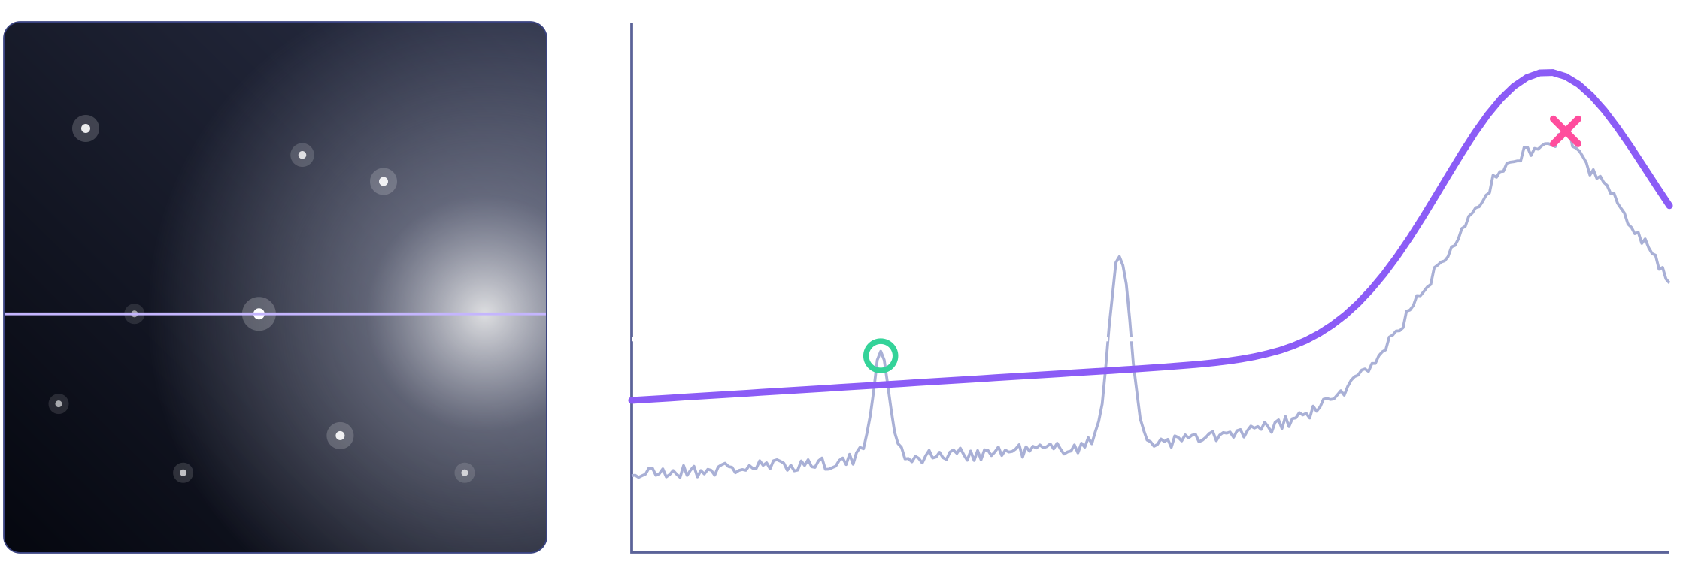
01 FEWER DECISIONS 02 MORE STARS 03 FLAT SENSORS
One brightness threshold can't fit the whole frame
brightness along that row ↑
LOCALLY ADAPTIVE BINARIZATION
Brightness along the marked row
One global threshold
v4: adapts to the local background
Faint star: recovered
✕
Glow noise: rejected
Real frames aren't uniform
v4 adapts the threshold locally
More stars, especially in corners
Vignetting, gradients and amp glow change the background from center to corner
Stricter where the frame is bright and noisy, more sensitive where it's clean
On by default. Remember the corners: they matter in chapter 3
ghilios.github.io/hocus-focus/settings/adaptive-binarization
Notes:
Step one of finding stars is deciding which pixels are bright enough to be "something". The old detector used one brightness threshold for the entire frame.
But real frames aren't uniform: vignetting, sky gradients, amp glow. On the left is a frame with a glow along one side; on the right is the brightness along that dashed row. The white dashed line is a single global threshold: it misses the faint star on the left — the green circle — and lets noise through inside the glow — the pink cross.
The purple line is what v4 does: the threshold follows the local background. The faint star is recovered, the glow noise is rejected.
The result is more real stars — and especially more stars in the corners. Remember the corners; they come back in chapter three. It's on by default, nothing to configure. The feature is called "Locally Adaptive Binarization" in the settings.
Docs — with the measurements behind this: https://ghilios.github.io/hocus-focus/settings/adaptive-binarization/

Slide 14
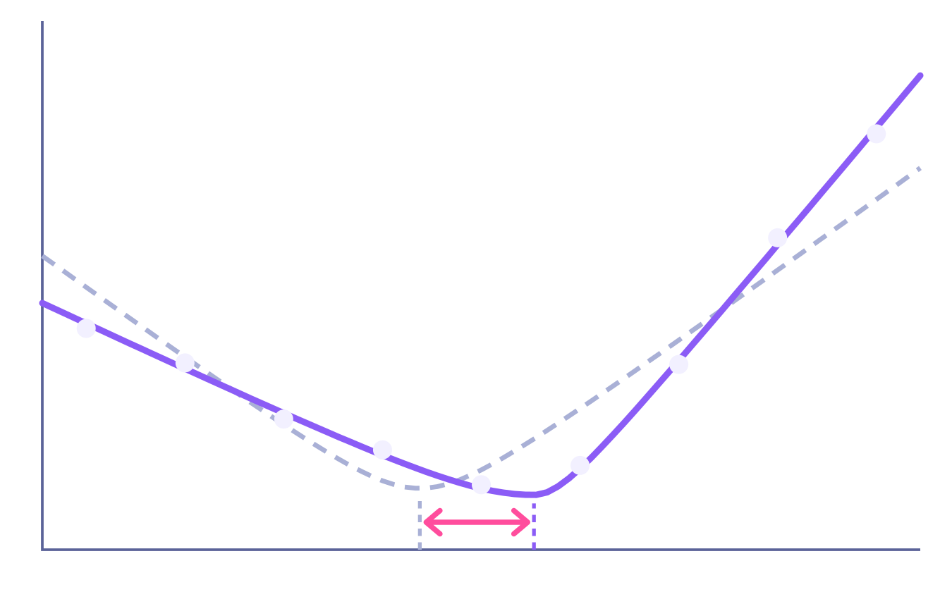
01 FEWER DECISIONS 02 MORE STARS 03 FLAT SENSORS
Real focus curves aren't symmetric
symmetric fit
fit that's allowed to lean
HYBRID (BEST FIT), THE NEW DEFAULT
Stars defocus differently on each side of focus
Force a symmetric V and best focus is pulled toward the shallow side
v4 tries several shapes, and only goes lopsided when the data justify it
star size ↑
best focus shifts
focuser position →
ghilios.github.io/hocus-focus/overview/hyperbola-fitting
Notes:
In 2023 I showed a slide called "Doesn't fit?" — real focus curves often aren't symmetric. Stars defocus differently inside and outside of focus.
If you force a symmetric V onto a lopsided curve — the dashed line — the fitted minimum gets pulled toward the shallow side. The pink arrow is the error in your "best focus".
v4 adds a Hybrid (Best Fit) mode, and it's the default. It fits several curve shapes to the same points, and it only picks a lopsided one when the data statistically justify the extra complexity. Clean symmetric data still gets a symmetric fit.
Backup: outliers are only rejected when every candidate model agrees; candidates are ranked by how precisely they locate best focus.
Docs: https://ghilios.github.io/hocus-focus/overview/hyperbola-fitting/

Slide 15
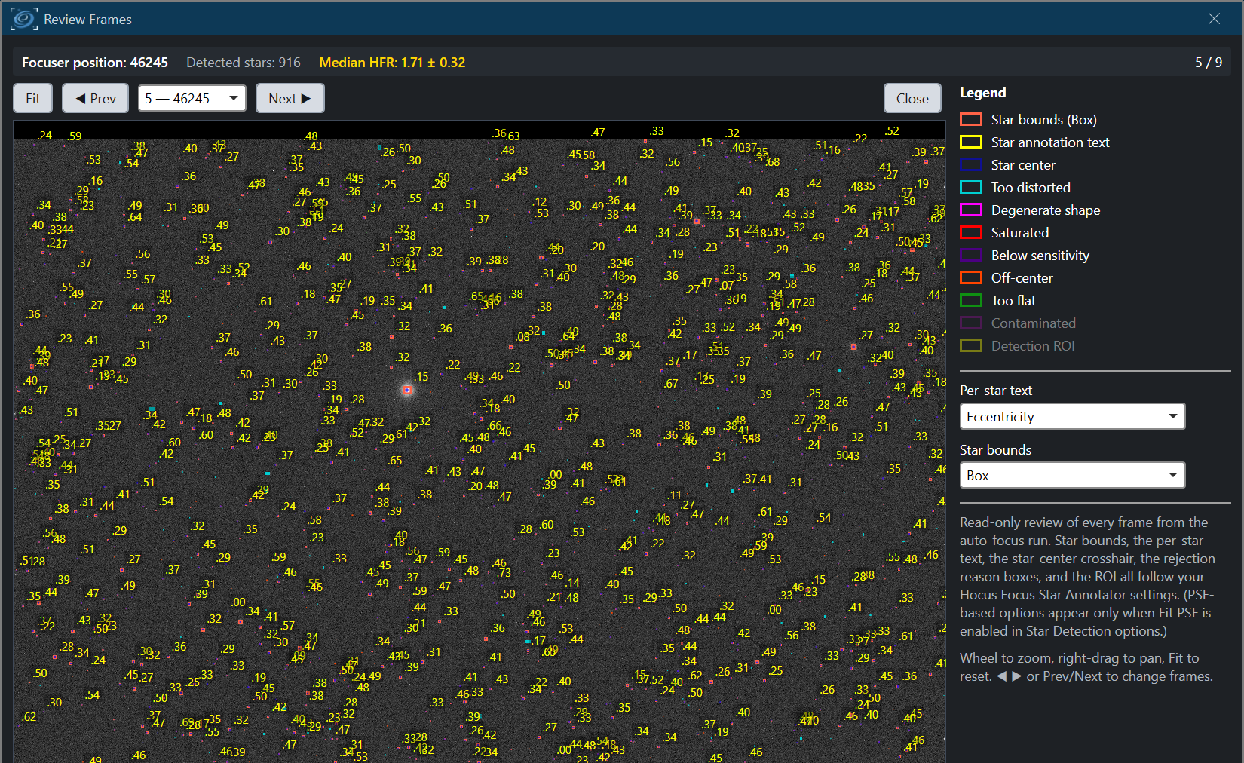
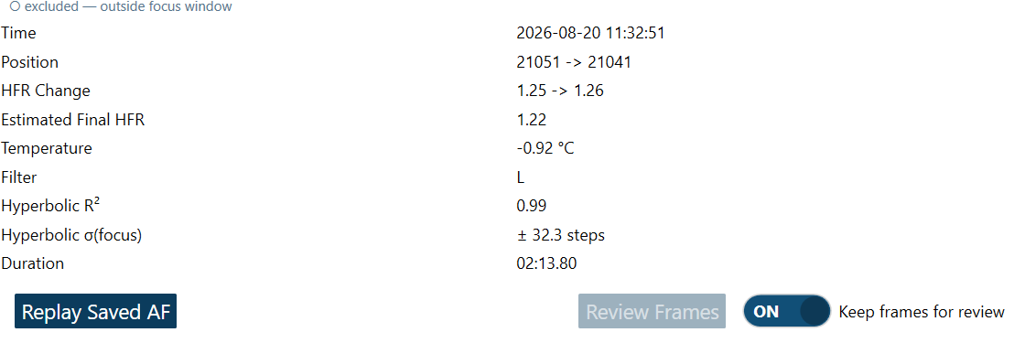
01 FEWER DECISIONS 02 MORE STARS 03 FLAT SENSORS
See what autofocus saw, frame by frame
AUTOFOCUS FRAME REVIEW
1
Turn on Keep frames for review
2
Run autofocus from the panel
3
Click Review Frames
ghilios.github.io/hocus-focus/overview/autofocus
Notes:
Until now, an autofocus run gave you a curve and you had to trust it. If one point looked wrong, you couldn't see why.
New controls under the autofocus chart: turn on "Keep frames for review", run autofocus from the panel, then hit "Review Frames". You can step through every frame in the sweep, with detected stars drawn on top, plus the focuser position, star count and HFR for that frame.
Keeping frames only applies to runs you start from this panel — autofocus inside a sequence doesn't hold frames in memory. And there's "Replay Saved AF" for re-analysing a run from disk with no equipment connected.
Docs: https://ghilios.github.io/hocus-focus/overview/autofocus/

Slide 16
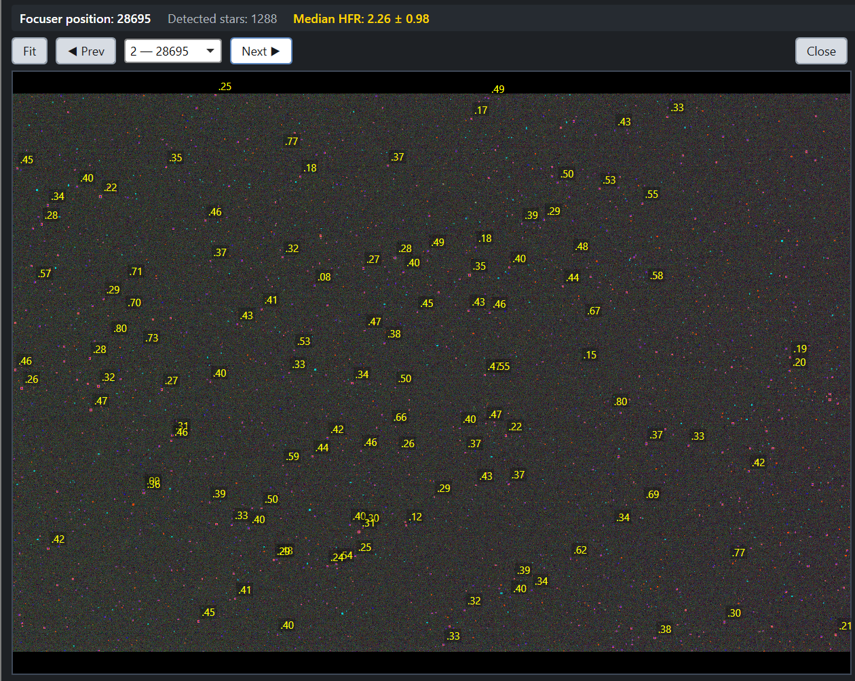
01 FEWER DECISIONS 02 MORE STARS 03 FLAT SENSORS
Spot the bad frame
What the detector saw
at every focuser position
Label the mistakes
and hand them back to the optimizer
Find the empty frame
or the donuts it missed
ghilios.github.io/hocus-focus/overview/autofocus
Notes:
This is what it's for. Here's a frame from the same run where detection went wrong — [describe: zero stars / donuts missed / junk detections].
You can see exactly what the detector saw at each focuser position. It's the fastest way to find the one frame that came up empty, and to understand whether your settings are the problem.
And it closes the loop with the optimizer: the wizard has the same kind of frame view, where you can box stars it missed or detections that are bogus, then choose "Optimize with feedback".
Docs: https://ghilios.github.io/hocus-focus/overview/autofocus/

Slide 17
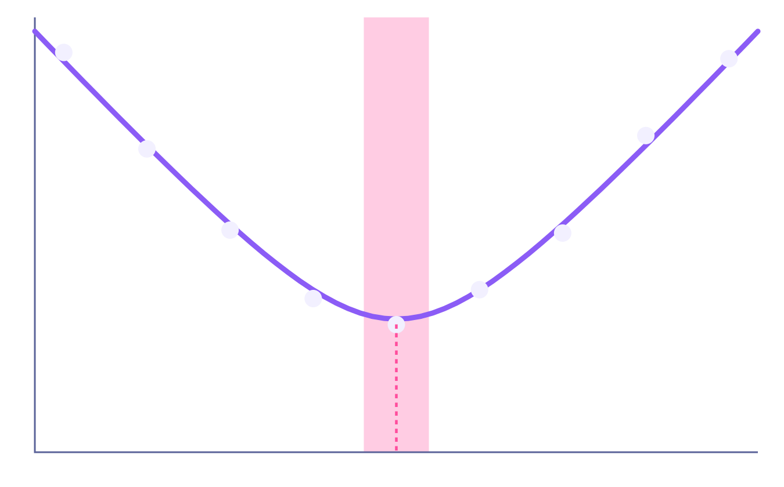
01 FEWER DECISIONS 02 MORE STARS 03 FLAT SENSORS
The optimizer chases a precise best focus
SNR
how precisely we know best focus
The goal: minimize the error in the calculated best-focus position
Each point is the average of every star in the frame
Averaging hundreds of stars = high SNR
star size (HFR) ↑
Autofocus is the easy case.
Tilt is not.
focuser position →
Notes:
Let me connect this back to the optimizer, because it sets up everything that follows.
For autofocus, the optimizer's goal is to minimize the error in the calculated best-focus position — the pink band around the minimum of this curve. The tighter that band, the more repeatable your focus.
Now notice what each point on this curve is: the average HFR of every star in the frame — often hundreds of stars. Averaging is a fantastic noise killer. A few missed stars, a few bad ones… the average barely moves. That is high signal-to-noise.
So autofocus is forgiving. It's the easy case. Tilt is not — and that's where SNR comes back.
Backup: the score also rewards star count, fit quality and coverage of the sensor, but focus precision dominates.

Slide 18
03
Flat sensors
Calibrating a tilt adapter · guided and automatic correction · simulators
Pause: questions so far?
Notes:
Pause for questions on detection and autofocus.
Chapter three is the big one: tilt and backfocus. In 2023 Hocus Focus could measure them. In v4 it tells you exactly what to do about them — and with the right hardware, does it for you.

Slide 19
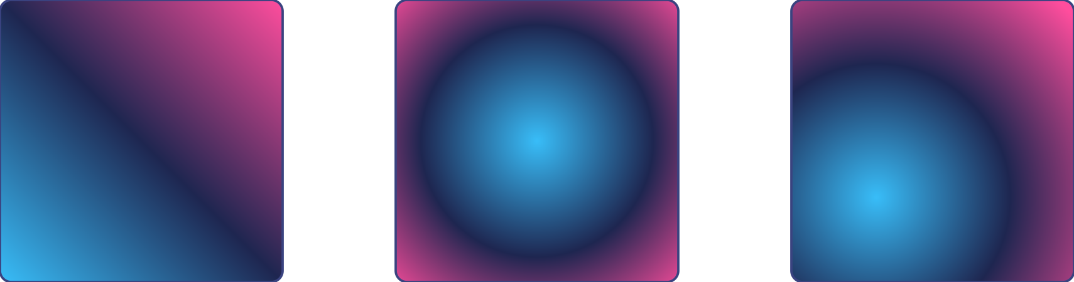
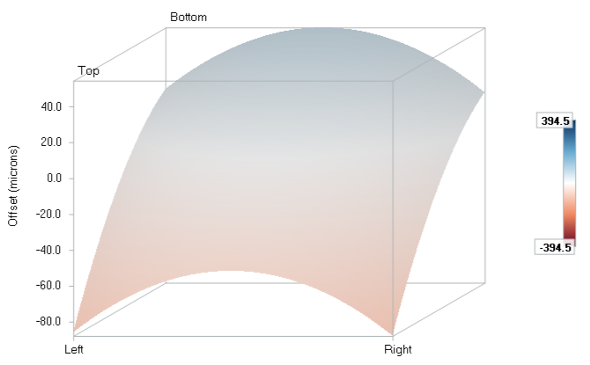
01 FEWER DECISIONS 02 MORE STARS 03 FLAT SENSORS
The sensor model, in one minute
+
=
Tilt
Curvature
Your sensor
one side focuses first
corners vs. center: backfocus
best focus across the frame
In the Aberration Inspector
In 2023 it told you that you had tilt. It didn't tell you what to do about it.
ghilios.github.io/hocus-focus/overview/sensor-model
Notes:
Quick recap from 2023. If you measure where best focus falls across the sensor, you get a surface. That surface is the sum of two things: a tilted plane — that's sensor tilt, one side reaching focus before the other — and a symmetric bowl — that's field curvature, which is how a backfocus spacing error shows up. Blue and pink here are just "focuses early" and "focuses late".
On the right is the real thing in the Aberration Inspector: the fitted surface for one of my runs, in microns.
In 2023 this told you THAT you had tilt, and roughly which way. What it didn't tell you was what to do about it: which screw, which direction, how far. That's what v4 adds.
Docs: https://ghilios.github.io/hocus-focus/overview/sensor-model/

Slide 20
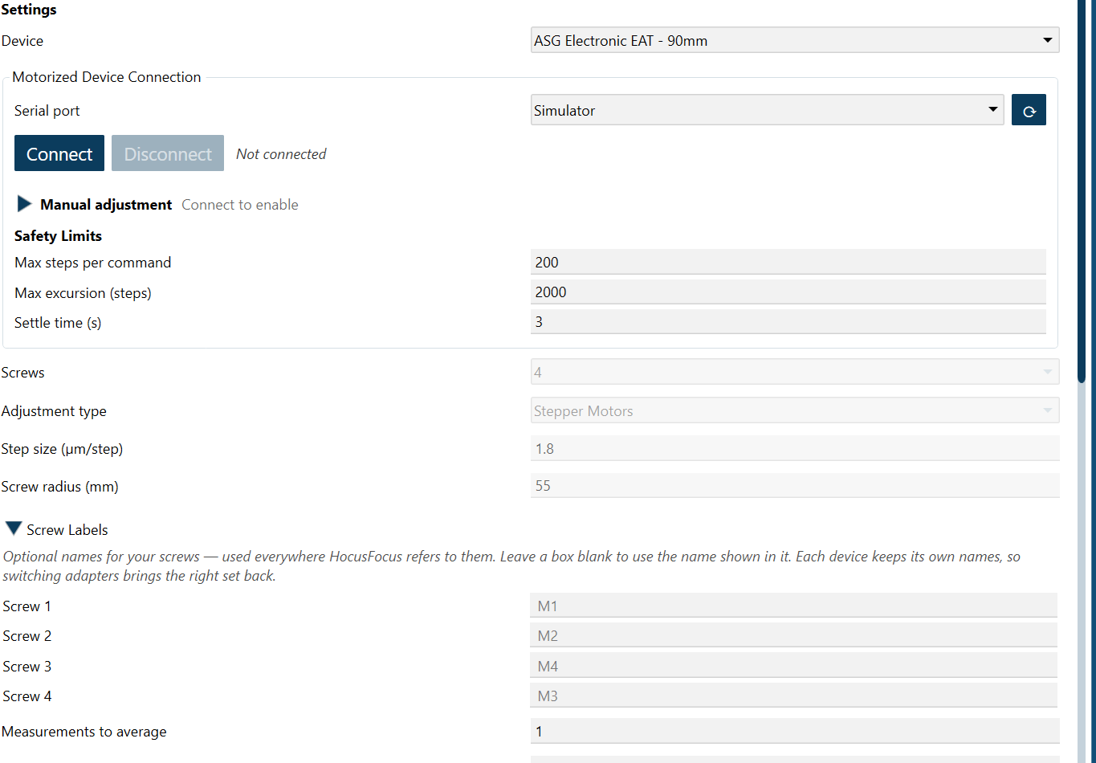
01 FEWER DECISIONS 02 MORE STARS 03 FLAT SENSORS
Which screw, which way, how far?
TELL IT ABOUT YOUR ADAPTER
Presets for popular adapters — Neumann, ASG, OGMA and more. Not listed? Message me and I'll add yours
3 or 4 screws, by hand or motor — manual adapters and the ASG EAT
Thread pitch and screw radius — filled in by the preset, or typed from your adapter's spec
Name the screws whatever you call them, and those names are used everywhere afterwards
ghilios.github.io/hocus-focus/overview/tilt-adapter-wizard
Notes:
Those are the three questions. A tilt measurement only becomes instructions once the software knows your adapter. To answer them, the software has to know your tilt adapter: where the screws are relative to the image, and how much each one moves the sensor. That's what the Tilt Adapter Calibration Wizard measures.
Setup is short. Pick your adapter from the presets — Neumann CTU, the ASG Photon Cage family, the motorized ASG EAT, the OGMA tilters — or choose Manual and type in the numbers. If your adapter isn't in the list, message me with its thread pitch, screw count and screw radius and I'll add a preset. Three-screw and four-screw adapters are both supported. You can name the screws whatever you call them, and those names are used everywhere afterwards.
Docs: https://ghilios.github.io/hocus-focus/overview/tilt-adapter-wizard/

Slide 21
01 FEWER DECISIONS 02 MORE STARS 03 FLAT SENSORS
Turn a screw, watch the tilt plane move
1
2
3
4
5
6
7
Baseline
Turn screw 1
Re-measure
Turn screw 2
Re-measure
All clockwise
Return
you turn
the wizard measures
optional: finds which way the adapter moves
SCREENSHOT NEEDED
screenshots/wizard-step.png
Tight crop: the step's instruction sentence + the screw diagram
Every step is a full focus sweep
A known turn in, a measured tilt change out
Re-measuring cancels thermal drift
ghilios.github.io/hocus-focus/overview/tilt-adapter-wizard
Notes:
Here's the process. Step one: a baseline measurement. Step two: the wizard asks you to turn screw 1 by a known amount — say one full turn clockwise — and measures again. Step three: put it back and re-measure. Step four: same thing with screw 2. Step five: a final re-measure.
Every one of those steps is a full focus sweep followed by a sensor model fit. The wizard is watching how the tilt plane moves in response to a known input. The re-measurements in between aren't wasted — they cancel out slow drift, like temperature changing during the run.
Two optional extra steps turn all screws clockwise together, which works out which direction your adapter moves — toward the camera or toward the telescope — instead of assuming it.
Four-screw adapters only need two screws measured: opposite screws are mechanically coupled.
Docs: https://ghilios.github.io/hocus-focus/overview/tilt-adapter-wizard/

Slide 22
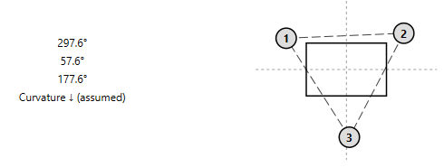
01 FEWER DECISIONS 02 MORE STARS 03 FLAT SENSORS
A measured map of your adapter
1
Where each screw sits, as the sensor sees it
Measured in the image, so mirrors, diagonals and rotators don't matter
2
How far each screw moves the tilt plane
Microns per turn (or per motor step), cross-checked against the adapter's spec
Measured, not assumed. But every step was a sensor model, and that is a demanding measurement…
DRAFT IMAGE → wizard-result.png
ghilios.github.io/hocus-focus/overview/tilt-adapter-wizard
Notes:
Two answers come out of the calibration.
One: where each screw sits, as the sensor sees it. This is derived from the measurements, not from looking at the adapter — which matters, because a star diagonal, a mirror, or a rotator can flip or rotate the image relative to the hardware. The wizard doesn't care; it measured the response in image space.
Two: how far each screw moves the tilt plane — effectively microns per turn, or per step for a motorized adapter. It's cross-checked against the adapter's mechanical spec, and the wizard warns you if they disagree.
You can save a calibration's data and replay it indoors later, and there's a manual entry path if you already know your geometry.
But notice: every one of those calibration steps was a sensor model. And a sensor model is a very demanding measurement — which brings us to the punchline.
Docs: https://ghilios.github.io/hocus-focus/overview/tilt-adapter-wizard/

Slide 23
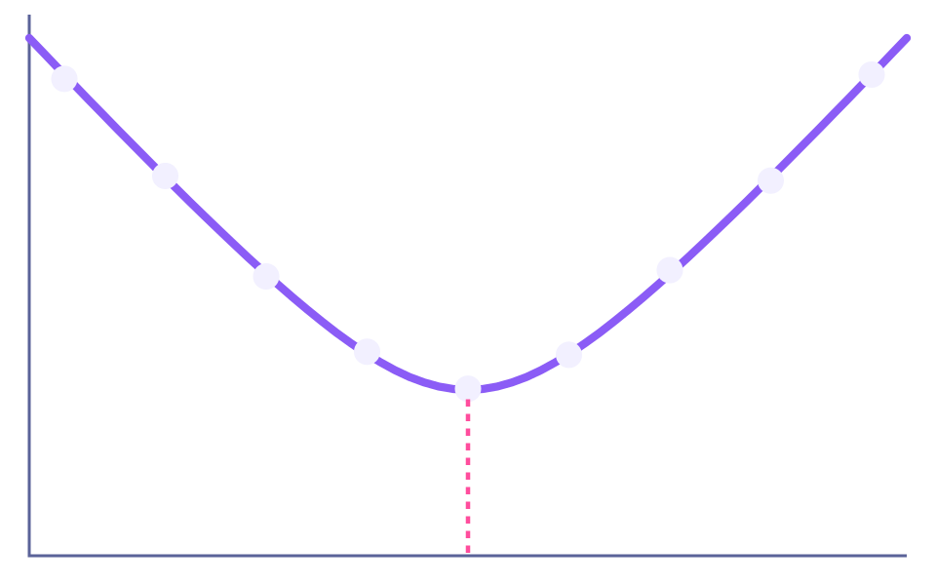
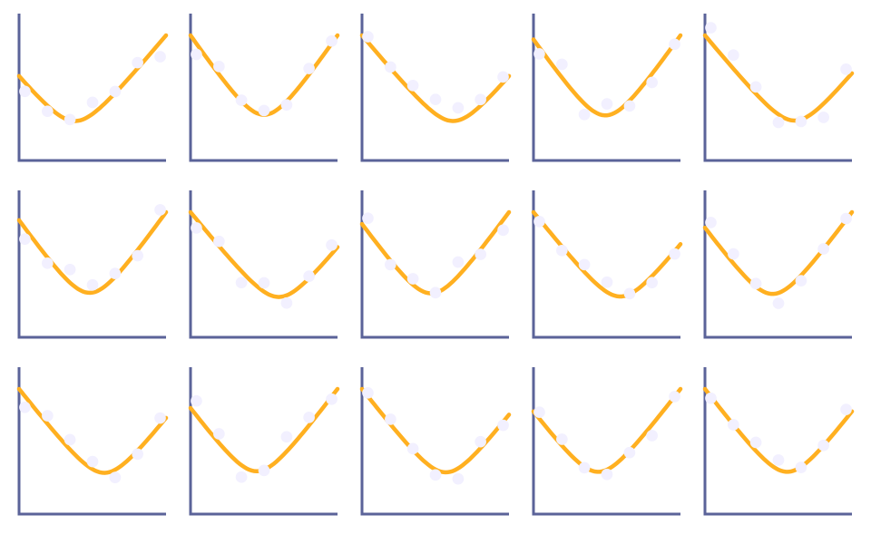
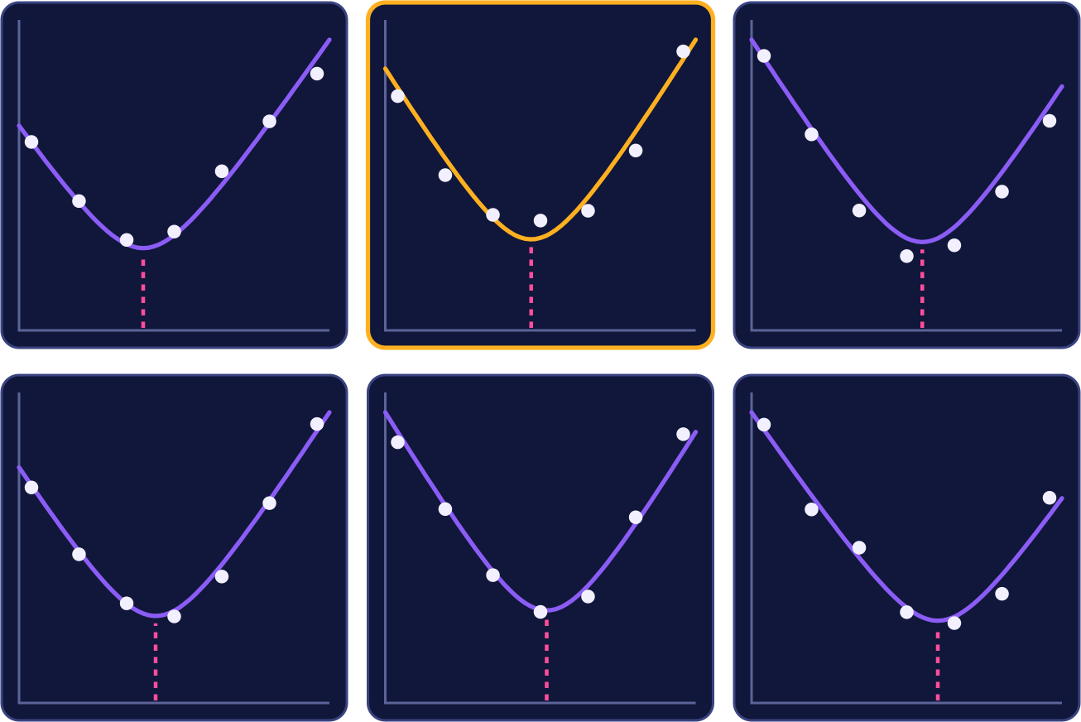
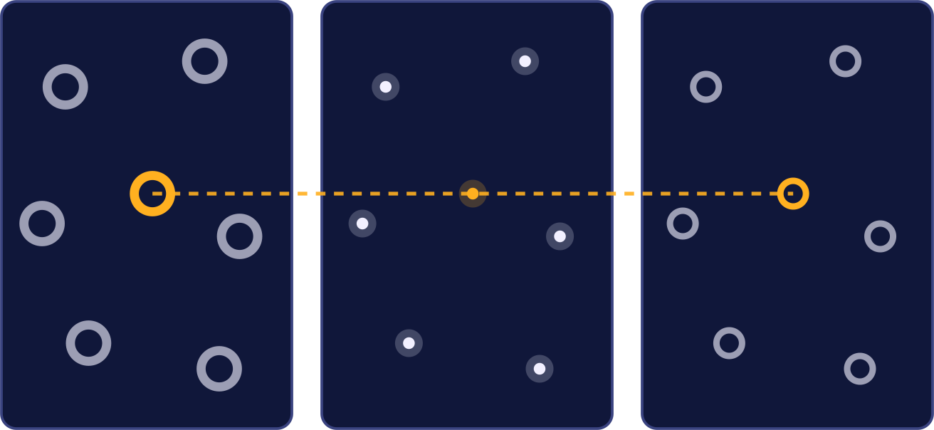
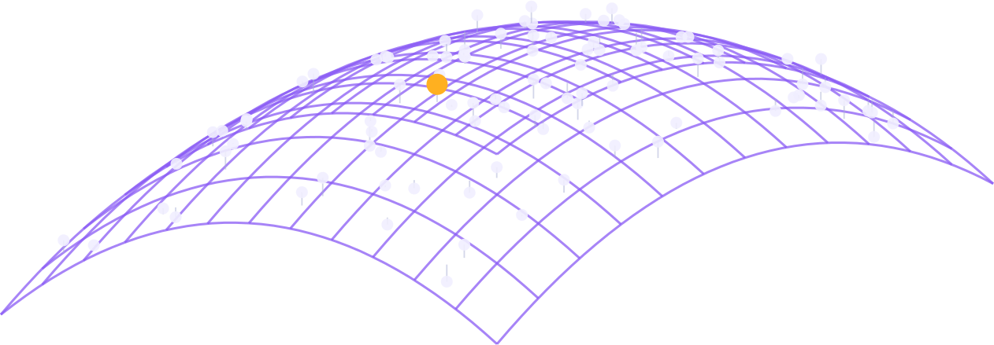
01 FEWER DECISIONS 02 MORE STARS 03 FLAT SENSORS
In a sensor model, every star matters
SNR
AUTOFOCUS
SENSOR MODEL
One curve
Hundreds of curves
Every point averages hundreds of stars
Every point is one star, in one frame, even far out of focus
High SNR, for free
Low SNR: every star must be measured well
1
Match stars
2
Fit each star
3
Fit a surface
Across every frame. Star registration by Steve Smith
Every star gets its own focus curve
Tilt and curvature fall out of it
Notes:
Here's the payoff for "why so many settings".
Compare the two measurements. Autofocus: ONE curve, where each point is the average of hundreds of stars. Averaging gives you high signal-to-noise for free.
Sensor model: HUNDREDS of curves — one per star — where each point is ONE star in ONE frame. No averaging to save you. Low SNR. So every single star has to be found and measured well, in every frame, including the out-of-focus ends of the sweep — and the stars you need most are in the corners, where they're faintest and most distorted.
How it works, along the bottom. Step one: match the same star across every frame of the focus sweep, from badly out of focus, through focus, and out the other side. Frames shift and stars change size, so this uses a RANSAC-based registration — thank you to Steve Smith for that implementation. Step two: fit a focus curve for each individual star, so each star gets its own best-focus position. Step three: fit a 3D surface through all of those positions across the sensor. Tilt and curvature fall out of that surface.
Every star matters, and getting enough signal out of each one is hard. Let me show you what that looks like.
Backup: a star must be matched in at least 5 frames with a good individual curve fit; the surface fit rejects outliers robustly. Docs: https://ghilios.github.io/hocus-focus/overview/sensor-model/

Slide 24
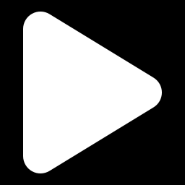
LIVE DEMO
A sensor model from a saved autofocus run
Imaging → Aberration Inspector → Load Saved AF
WATCH FOR
WATCH FOR
WATCH FOR
How many stars make it into the model
One focus curve per star
The 3D surface: tilt and curvature, in microns
Notes:
LIVE DEMO — sensor model on a saved autofocus run. About 5 minutes.
Before the talk: NINA open on the Imaging tab with the Aberration Inspector dock visible and wide; "Sensor Curve Model Enabled" ON in the inspector options; saved run folder picked out in advance (dense star field, visible tilt); do one dry run so you know how long it takes.
Script:
1. Aberration Inspector → Load Saved AF → pick the AutoFocus_<date> folder. Mention: no equipment needed, this is a replay.
2. While it runs: every frame is being re-detected, stars matched across frames, one curve fit per star.
3. When it lands: point at "Points in Model" — that's how many individual stars survived. Every one had to be found in most frames of the sweep.
4. Show the 3D surface: the slope is tilt, the bowl is curvature/backfocus. Rotate it.
5. Show Model Properties and the Model Analysis checklist: tilt effect and curvature effect in microns, graded against the critical focus zone.
6. Tease the Tilt Adapter Guidance section — we'll come back to it in a few slides.
If the demo misbehaves: the next slide (hidden) has screenshots of the same kind of result — unhide or jump to it.

Slide 25
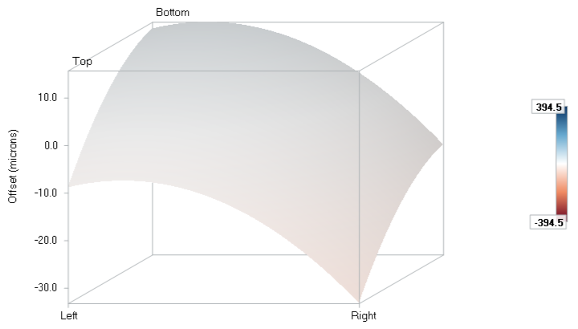
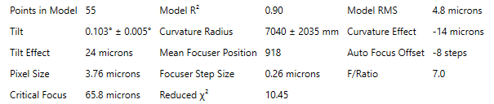
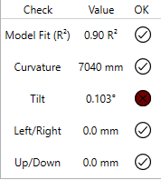
01 FEWER DECISIONS 02 MORE STARS 03 FLAT SENSORS
One fitted sensor model (demo backup)
2
Points in Model: the stars that survived
3
Each effect is graded against the critical focus zone. Here curvature passes and tilt fails.
1
The slope is tilt; the bowl is curvature
Notes:
Hidden slide — only needed if the live demo fails. All three crops are from the same run.
1: the fitted 3D surface — slope is tilt, the bowl is curvature.
2: "Points in Model" is the count of individual stars that survived matching and per-star curve fitting.
3: the analysis grades each effect against the critical focus zone: here curvature passes, tilt fails.

Slide 26
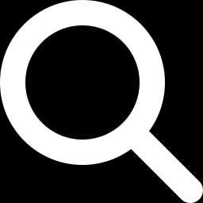
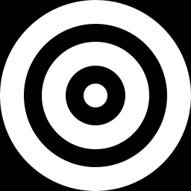
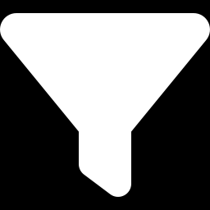
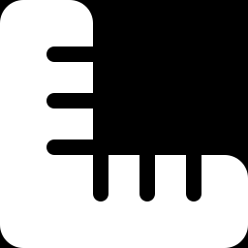
01 FEWER DECISIONS 02 MORE STARS 03 FLAT SENSORS
That's why there are so many settings
SNR
Every optical system is different
One-size-fits-all detection works most of the time for autofocus. It isn't precise enough for a sensor model.
Find faint stars
Survive defocus
Reject junk
Measure precisely
Each of these settings exists because I found a real difference between real setups. None was added on a hunch.
40+ settings, four jobs
FOR EVERYONE, NOT JUST TILT
A properly tuned detector pins down best focus with very low error. That error is now reported with every autofocus result.
ghilios.github.io/hocus-focus/settings
Notes:
So back to that wall of settings. Every optical system is different: focal ratio, central obstruction, corrector, pixel scale, sky, filters. A one-size-fits-all detector works most of the time for autofocus, because averaging hides its mistakes. It does not measure precisely enough for a sensor model, where every star is measured on its own.
The settings fall into four jobs. Find faint stars: the thresholds and structure settings, adaptive binarization. Survive defocus: donut detection and the defocus-aware gates. Reject junk: hot pixels, saturated stars, distorted shapes, stars contaminated by a neighbour. Measure precisely: PSF fitting, background estimation, how measurements are averaged.
I want to be clear that none of these was added on a hunch. Each one exists because I found a real difference between real setups in the autofocus runs people sent me, and one fixed value got it wrong for some of them.
And this isn't only for tilt work. A properly tuned detector pins down best focus with very low error — and that error is now reported with every autofocus result, so you can see how good your focus actually is. That's why the optimizer exists — remember the "Optimize for aberration inspection" toggle on its start page? That tells it to favor finding many more stars across the frame, which is what the sensor model needs.
All documented: https://ghilios.github.io/hocus-focus/settings/

Slide 27
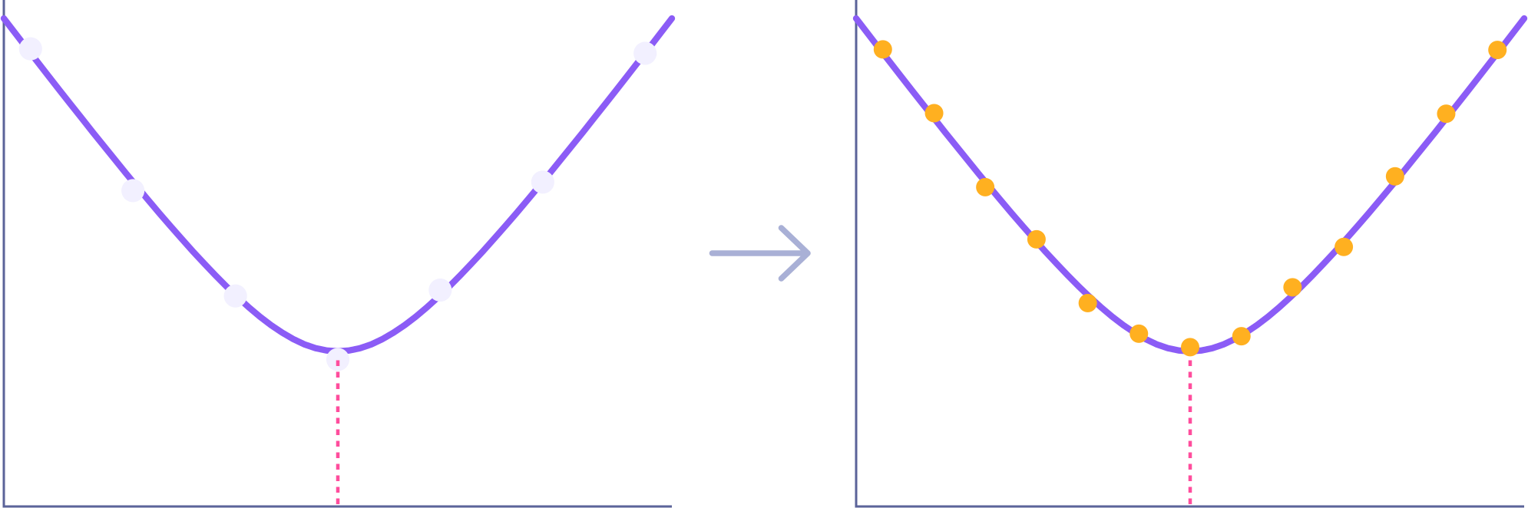
01 FEWER DECISIONS 02 MORE STARS 03 FLAT SENSORS
“Signal Amplification”: more frames, more signal
SNR
More points on every star's curve
Smaller focus jumps between frames, so stars are easier to match
The cost is exposures: a calibration is several sweeps
Normal sweep
2×: same range, half the step, twice the frames
star size vs. focuser position
One number, in the inspector and the wizard
ghilios.github.io/hocus-focus/overview/tilt-aberration-inspector
Notes:
There's one more way to get more signal, and it has nothing to do with detection settings: take more frames.
Signal Amplification divides your autofocus step size by N and multiplies the number of steps by N. The sweep covers exactly the same focus range — it just samples it more finely. On the left, a normal sweep; on the right, the same sweep at 2x — which is what the wizard screenshot below is set to.
Two benefits. Every star's individual curve gets more points, so its best-focus estimate is tighter. And the jump in defocus between neighbouring frames is smaller, so stars are easier to match from one frame to the next.
The cost is time: N times the exposures per sweep — and a tilt adapter calibration is five to seven sweeps. The wizard shows a live estimate of how many images you're signing up for. It applies to live captures only.
Docs: https://ghilios.github.io/hocus-focus/overview/tilt-aberration-inspector/

Slide 28
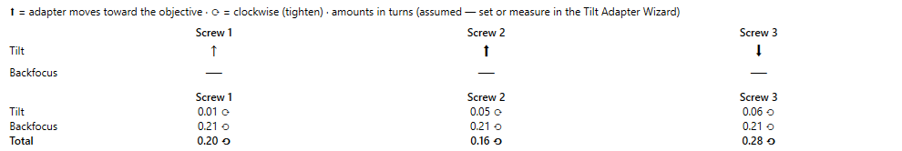
01 FEWER DECISIONS 02 MORE STARS 03 FLAT SENSORS
Now it tells you how far to turn each screw
1
2
3
DRAFT IMAGE → guidance.png
1
The legend, in your units
2
Arrows: which way
3
Numbers: how far
Turns, degrees or clock-minutes. Motor steps for motorized adapters
The direction each corner of the adapter needs to move
Per screw, split into Tilt, Backfocus, and the Total you apply
ghilios.github.io/hocus-focus/overview/tilt-aberration-inspector
Notes:
Now the payoff of calibration. Once the adapter is calibrated, every Detailed Analysis in the Aberration Inspector comes with a Tilt Adapter Guidance section.
One: the legend — what the symbols mean, and your units. You can display turns, degrees, or minutes on a clock face; a motorized adapter shows motor steps.
Two: the arrows — for each screw, which way that corner of the adapter needs to move; a bigger arrow means a bigger move.
Three: the numbers — how far to turn each screw, split into three rows: the part that fixes tilt, the part that fixes backfocus, and the total you actually apply. The rotation symbol tells you clockwise or counter-clockwise.
Docs: https://ghilios.github.io/hocus-focus/overview/tilt-aberration-inspector/

Slide 29
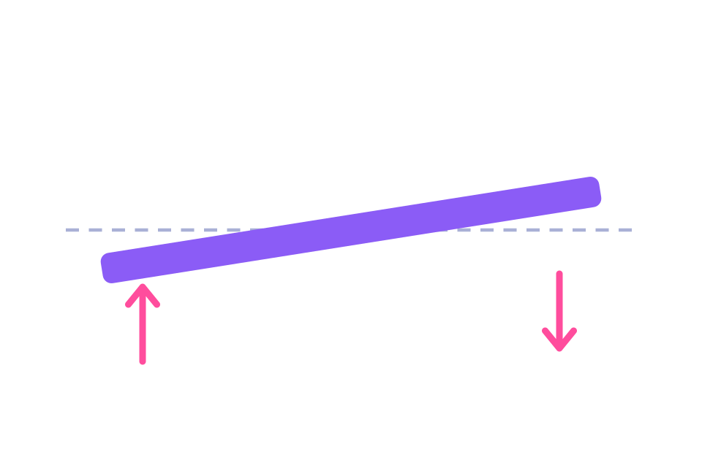
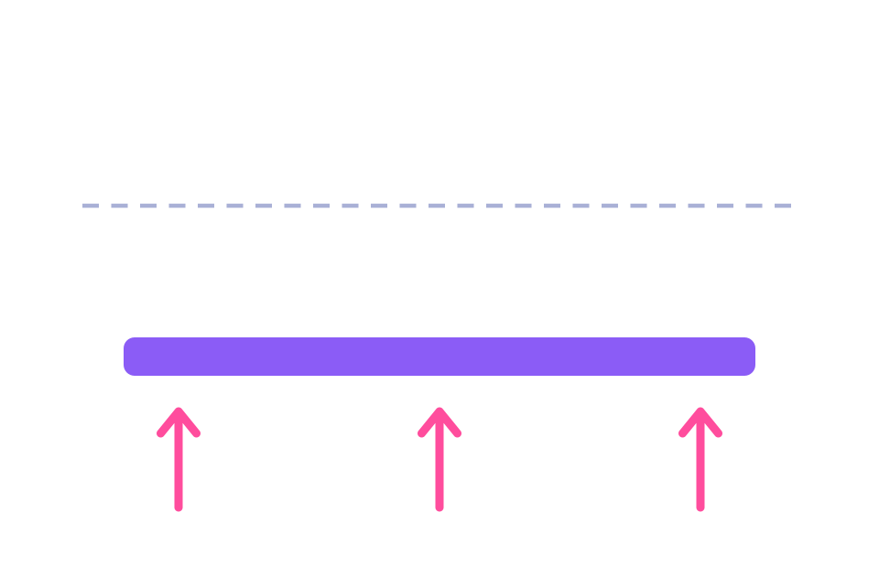


01 FEWER DECISIONS 02 MORE STARS 03 FLAT SENSORS
Tilt and backfocus are separate fixes
What's left is your optics
Each effect is graded against your critical focus zone, so you know when you're done.
Model fit
explains the data
Tilt
Backfocus
Curvature
within tolerance
The fix: turn the screws differently
The fix: turn them all the same way, or add a spacer
Tilt
too large: adjust
Dashed: where focus wants the sensor. Bar: the sensor. Arrows: the fix.
ghilios.github.io/hocus-focus/overview/tilt-aberration-inspector
Notes:
Why split it into tilt and backfocus? Because they're different motions of the same screws. In both pictures the dashed line is where the focal plane wants the sensor to be, the purple bar is the sensor, and the pink arrows are the fix.
Tilt is corrected by turning screws differently — one side up, the other side down — so the plane tips.
Backfocus is corrected by turning all the screws the same way, moving the whole sensor along the optical axis. If it needs more travel than the adapter has, that's a spacer.
Seeing them separately means you can choose: fix tilt tonight, order a spacer for the backfocus.
And whatever remains after both is simply your optics — the residual curvature of your corrector. The Model Analysis grades each against your critical focus zone — tilt within a quarter of it, curvature within one and a half times — so you know when to stop.
Docs: https://ghilios.github.io/hocus-focus/overview/tilt-aberration-inspector/

Slide 30
01 FEWER DECISIONS 02 MORE STARS 03 FLAT SENSORS
Measure, turn, re-measure: watch the tilt converge
Each round, the correction gets smaller
The history keeps every measurement of the session
Stop when tilt is inside your critical focus zone
SCREENSHOT NEEDED
screenshots/tilt-history.png
Tilt Measurement History after 2–3 measure/adjust rounds
ghilios.github.io/hocus-focus/overview/tilt-aberration-inspector
Notes:
In practice it's a loop: run a Detailed Analysis, turn the screws by the amounts shown, run it again.
The inspector keeps a history of every measurement in the session, so you can watch the tilt come down. [Talk through the screenshot: first measurement, after one adjustment, after two.]
You stop when the tilt effect is inside the tolerance the analysis checks against the critical focus zone.
[If you have real before/after corner-star crops, this is the slide to show them.]
Docs: https://ghilios.github.io/hocus-focus/overview/tilt-aberration-inspector/

Slide 31
01 FEWER DECISIONS 02 MORE STARS 03 FLAT SENSORS
With an ASG EAT, calibration runs itself
SCREENSHOT NEEDED
screenshots/eat-connection.png
Motorized Device Connection + motor positions grid (Simulator port is fine)
Press Auto Run All.
Walk away.
Four motors driven directly from N.I.N.A. The wizard makes every move and every measurement itself. Cancel at any time and it puts the motors back.
THANK YOU
Josh Jones at ASG, for the EAT that made this automation possible
ghilios.github.io/hocus-focus/overview/motorized-tilt-adapter
Notes:
The 2023 slide said "Motorized tilt adjusters?" with a question mark. The ASG EAT is exactly that: an electronic tilt adapter with four stepper motors instead of four screws. Hocus Focus now drives it directly from NINA.
A huge thank-you to Josh Jones at ASG, who provided an EAT so I could build and test this.
Connect to it from the Tilt Adapter Wizard, and calibration becomes hands-off: press Auto Run All and the wizard moves the motors, runs each sweep, and works through every step on its own. Go have dinner.
If you cancel part-way, it puts the motors back where they started.
Backup: motor positions live in the adapter's own memory and survive power cycles; the plugin never zeroes them. Safety limits cap steps per command and total travel.
Docs: https://ghilios.github.io/hocus-focus/overview/motorized-tilt-adapter/

Slide 32
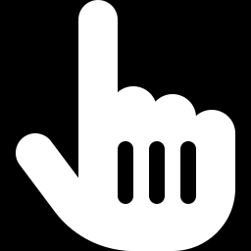
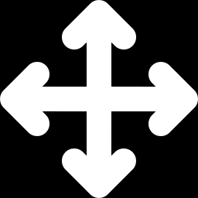
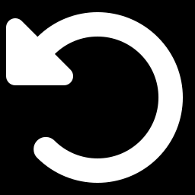
01 FEWER DECISIONS 02 MORE STARS 03 FLAT SENSORS
Then it corrects tilt and backfocus for you
SCREENSHOT NEEDED
screenshots/eat-review-commands.png
“Review motor commands” approval dialog
You approve every move
Review each motor command first. Apply tilt, backfocus, or both
At most three moves
For a complete tilt and backfocus correction
Got worse? Revert
One click undoes the moves. Then measure again
ghilios.github.io/hocus-focus/overview/motorized-tilt-adapter
Notes:
With a calibrated, connected EAT, the guidance section gets one more button: Automatic Adjustment.
It works out the motor moves from the current measurement and shows you this review dialog first. Nothing moves until you approve. You can choose to apply tilt, backfocus, or both; you see each move, and what residual will be left.
A full tilt-plus-backfocus correction is at most three motor commands.
Afterwards you re-measure. If tilt somehow got worse — stale calibration, camera rotated since — you get a banner with a one-click Revert that undoes the moves.
There's also a manual pad for nudging corners, and you can return to the motor positions of any earlier measurement in the session.
Docs: https://ghilios.github.io/hocus-focus/overview/motorized-tilt-adapter/

Slide 33
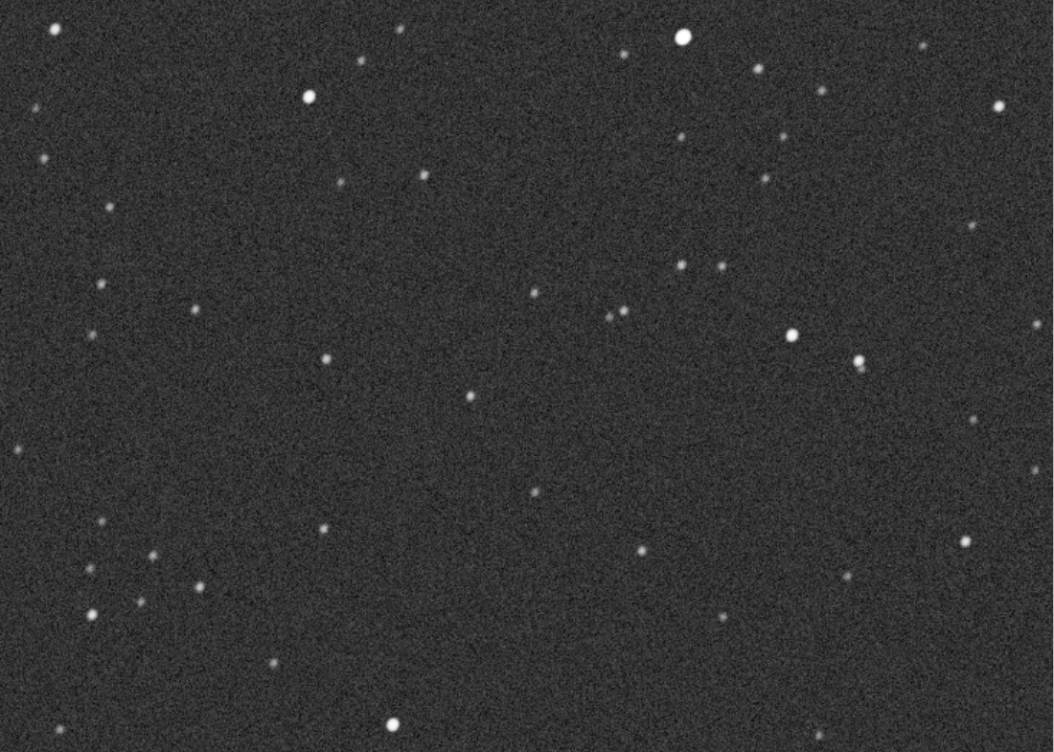

01 FEWER DECISIONS 02 MORE STARS 03 FLAT SENSORS
Rehearse all of it indoors
SCREENSHOT NEEDED
screenshots/sim-tilt-panel.png
Simulator Tilt Adapter panel at ✓ ≈ flat
A camera simulator with real stars
It defocuses like your scope
Virtual screws, or a virtual EAT
Catalog stars for wherever the mount points, with real sensors, filters, seeing and noise
Donuts included. Inject tilt and backfocus error on purpose
Run autofocus, calibration and correction on a cloudy day
ghilios.github.io/hocus-focus/overview/camera-simulator
Notes:
One more thing, mostly for the curious. Building all of this needed a way to test without clear skies, so Hocus Focus now includes a camera simulator — and it's surprisingly sophisticated.
It renders real catalog stars for wherever your mount is pointing, through a model of your optics and a real sensor — IMX455, 571, 533 and so on — with filters including narrowband, sky brightness, seeing, and realistic noise. Defocus it and you get donuts.
Most importantly, you can inject tilt and backfocus error. Pair it with the simulated tilt adapter — virtual screws you click — and you can run autofocus, a full tilt adapter calibration, guided correction, even the EAT automation, entirely indoors on a cloudy day. When you've got it right, the panel reads "approximately flat".
It's the best way to get a feel for the process before you touch a real screw. The documentation walks you through it.
Docs: https://ghilios.github.io/hocus-focus/overview/camera-simulator/

Slide 34

Why every star matters
01 FEWER DECISIONS
02 MORE STARS
03 FLAT SENSORS
Too many settings? The optimizer sets them for you.
Donuts, adaptive thresholds, better fits, frame review.
Calibrate the adapter, then guided or automatic correction.
SNR A sensor model needs every star measured well. That is why the settings exist.
IT'S ALL DOCUMENTED
ghilios.github.io/hocus-focus
Quick start · every setting · the optimizer · tilt adapter wizard · motorized adapters · simulator
Notes:
To wrap up. The complaint was "too many settings". The optimizer means you don't have to set them. But they exist for a reason, and the reason is signal-to-noise: a sensor model needs a clean measurement of every individual star, across the whole frame, in and out of focus.
Get that right, and you can calibrate your tilt adapter — and once it's calibrated, Hocus Focus tells you exactly how far to turn each screw, separately for tilt and backfocus. With an ASG EAT, it turns them for you.
Everything tonight is in the documentation — scan the code or go to https://ghilios.github.io/hocus-focus/. There's a quick start, a page per feature, and the simulator walkthrough if you want to try this indoors first.

Slide 35


Thank you
DOCS AND QUICK START
ghilios.github.io/
hocus-focus
Questions?
WITH THANKS TO
jokogeo
Steve Smith
N.I.N.A. Discord
for the RANSAC star registration
github.com/ghilios/hocus-focus
Josh Jones, ASG
Open source (MPL 2.0) · ghilios on Cloudy Nights
for the EAT that made the automation possible
The community
for saved autofocus runs, bug reports, and patience
Notes:
Thank you. Credits: Steve Smith for the RANSAC star registration that makes matching stars across a focus sweep work; Josh Jones at ASG for providing the EAT; and everyone in the community who sent me saved autofocus runs — that bank of real data is what all of this was tuned and tested against.
I'm jokogeo on the NINA Discord and ghilios on Cloudy Nights. The plugin is open source on GitHub. The docs link stays on screen. Questions?

